Slide 1
MIS 407
Week 1, Class 2
Aug. 24, 2016
Prof. Smith
timsmith@iastate.edu

Slide 2
For Today…
Python 2.7.x versus 3.5.x
Revisit: GitHub and Slack accounts.
Review Slack
Introduce Git
Assign teams

Slide 3
Python versions
In MIS407 - We will only use Python 3.5.x
There are two current versions of Python 2.7.x and 3.5.x.
Why is this?
In Python 3 broke backward compatibility.
This was necessary to clean up and advance the language.
The downside, the huge code base of version 2 python would need to be rewritten (updated really).
Thus, Python 2 lives on much longer that it probably should have.
Python 2
now only receives security and bug fixes – no new functionality will be added.
EOL Date (End of Life) for 2.7 is 2020. No fixed/updates after that.

Slide 4
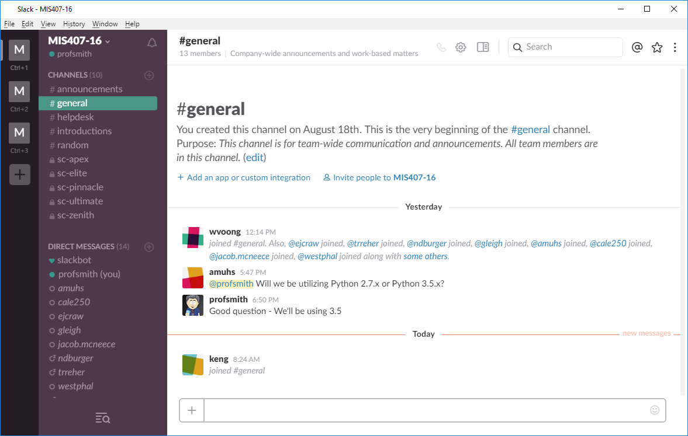
Let’s all get Slack…

Slide 5
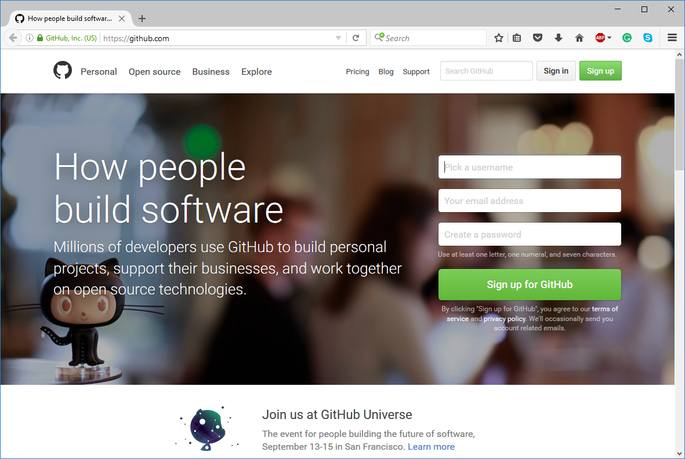
Get your GitHub account!
If you haven’t already done so You must create your account, and send me your username ASAP!

Slide 6
Intro to Git
Git is a VCS (version control system).
Most large, multi-member, group projects will use some form of VCS
Git is one of the most popular.

Slide 7
History of Git
Developed by Linus Torvalds (Linux Fame)
He wasn’t happy with existing VCS’s
They had a number of problems, and were generally slow and cumbersome.
He hated existing VCS so much that he didn’t even use them in his Linux Kernel project
He used tar balls and patches – a rather “manual” method.

Slide 8
Why Git
Our projects really won’t be that large, so why?
Group work
The power of “versioning”
MOST importantly, it’s a key means through which to participate in a programming community.
See 7:13 onward of … https://www.youtube.com/watch?v=Vo9KPk-gqKk

Slide 9
Intro Concepts
A “repo” is a repository of your code who’s state is managed by Git.
Files are tracked, untracked, or ignored.
There are multiple Git clients out there, we will use the official release from
www.git-scm.com.
NOTE: We will only be using the command land version. Knowing the command line version will allow you to more fully understand and control Git.

Slide 10
General Process
Initialize a repo
Add .gitignore file – if necessary
Add any untracked files to the “staging area”.
Commit changes to the repo when you’re satisfied with changes.

Slide 11
Let’s try this now…
Got to our GitHub team site…
Work through the following:
git_basic_local_workflow.md
git_experimental_branch.md
git_rollback.md

Slide 12
Let’s now assign teams…
Team building skill is an essential part of being an effective employee.
In the “real world” your rarely get to choose who you work with on a team.
<<bring up spreadsheet… and randomize the list to choose team members>>

Slide 13
By next class…
If haven’t already…
Create a GitHub account, and email me your userID
Join our MIS407 “Slack” team and introduce yourself to the class and to your team
During Next class…
We’ll work on using Git and GitHub
I’ll spend time introducing our Python programming environment and workflow

